Slide 1



Capturing loop parallelisability property: from source code parallelisability metrics to machine-learning based assistance tool
PPar Lunch Talk
January, 23, 2019
Aleksandr Maramzin, s1736883

Slide 2
Background
High-level Software Parallelisation Problem Statement
Software Quality Metrics as a Work Motivation
Program Dependence Graph (PDG) and Loop Iterator Recognition

Slide 3
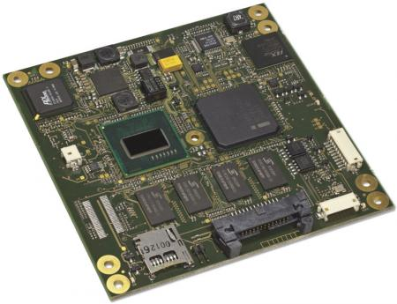




High-level Problem Statement
Abundance of parallel hardware across the whole spectrum of computing systems (from small embedded devices to warehouse-scale server farms)
Difficulty of manual parallel programming (requires application domain knowledge, parallell programming skills (synchronisation, deadlocks, race conditions, etc.), knowledge of exact frameworks (OpenMP, MPI, etc.)
Automatic parallelisation tools are conservative and limited in their abilities to exploit all available application parallelism

Slide 4

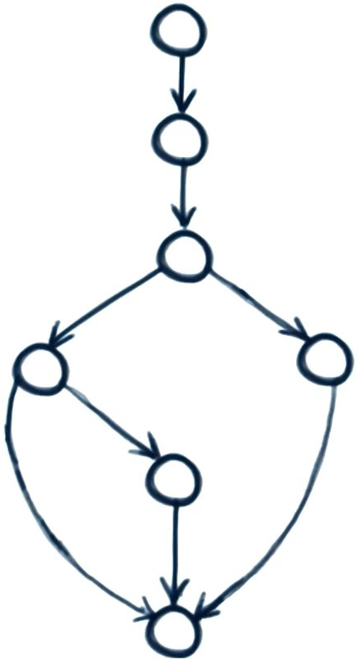
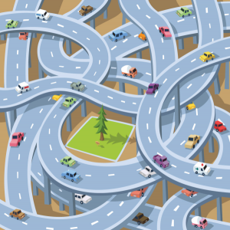
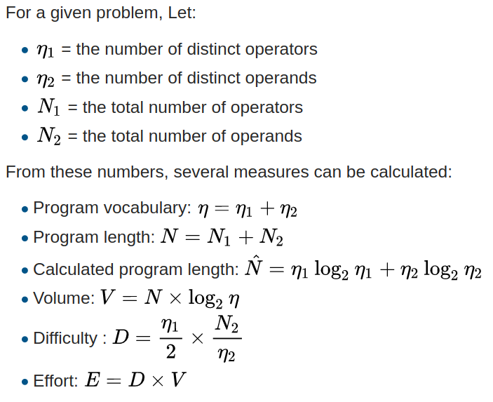
Software Source Code Metrics in Software Engineering
Software Quality
Parallel Programming
Cyclomatic Complexity (CC)
Lines Of Code (LOC)
The only metrics in the subfield are different variations of speedup
$speedup=\frac{\text{serial execution time}}{\text{parallel execution time}}$
Bugs per line of code
Relative speedup (serial algorithm vs parallel algorithm)
Real speedup (best known serial algorithm vs parallel algorithm)
Absolute speedup (best known serial algorithm on the best serial hardware vs parallel algorithm)
Analytical speedup
Asymptotic speedup (O_{serial}(n)/O_{parallel}(n))
Halstead’s Software Science
Code coverage
Software Coupling
&
Cohesion

Slide 5
Program Dependence Graph and Iterator Recognition Works
Program Dependence Graph (PDG) is an IR graph, representing both data and control dependencies between instructions
Generalized Loop Iterator is a Strongly Connected Component on a PDG with no incoming dependence edges in the Component Graph
The Program Dependence Graph and Its Use in Optimization. Jeanne Ferrante (IBM T. J. Watson Research Center), Karl J. Ottenstein (Michigan Technological University), Joe D. Warren (Rice University). ACM Transactions on Programming Languages and Systems, 1987.
Generalized Profile-Guided Iterator Recognition. Stanislav Manilov, Christos Vasiladiotis, and Björn Franke (The University of Edinburgh). Proceedings of 27th International Conference on Compiler Construction (CC’18).

Slide 6
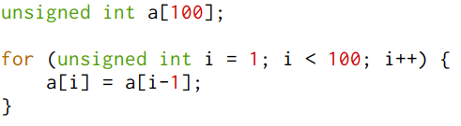
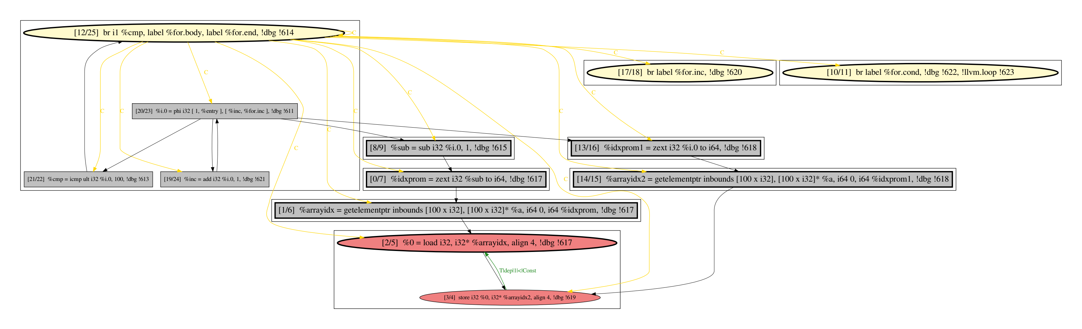
Dependence based Anatomy of a Loop
*
Loop Iterator
Loop Critical Payload

Slide 7
Software Parallelisability Metrics
Proposed Software Parallelisability Metrics
Metrics Correlation with Loop Parallelisability

Slide 8
Software Metrics for Parallelism [40]
Metric Group | Metric | Metric Definition | Intuition
Loop Proportions | Absolute Size | Number of LLVM IR instructions in a whole loop | The bigger the loop, the harder it is to parallelize it
 | Payload Fraction |  | The smaller the payload fraction (hence, the more complex iterator is), the harder it is to parallelize a loop
 | Proper SCCs Number | Number of SCCs with more than one LLVM IR instruction in a payload of a loop | The more proper SCCs we have, the harder this loop is for parallelization
 | Critical Payload Fraction |  | The bigger the critical part of a loop, the harder it is to parallelize a loop
Loop Dependencies Number | Payload Dependencies Number | Number of PDG edges in a payload (True, Anti, Output and Total) | The more dependencies we have, especially in the critical part of a loop payload, the harder it is to parallelize a loop
 | Critical Payload Dependencies Number | Number of PDG edges in a critical payload (True, Anti, Output and Total)
Loop Cohesion | Iterator/Payload Cohesion |  | No apparent intuition
 | Critical/Regular Payload Cohesion |  | The tighter a regular payload is coupled with payload’s critical part (more edges in between, bigger cohesion value), the harder it is to parallelize a loop
Loop Instruction Nature | Call instructions count | Number of call instructions in iterator, payload and critical payload of a loop | Uninlined calls prevent loop parallelisation
 | Branch instructions count | Number of branch instructions in iterator, payload and critical payload of a loop | Branch instructions implement breaks, returns and a complicated CF in a loop body, what effectively hinders loop parallelisation
$\frac{PayloadInstructionsNumber}{TotalLoopInstructionsNumber}$
$\frac{CriticalPayloadInstructionsNumber}{PayloadInstructionsNumber}$
$\frac{EdgesNumberBetween{Iterator}/{Payload}}{TotalLoopEdgesNumber}$
$\frac{EdgesNumberBetween{Critical}/{Non}\text{-}criticalPayload}{TotalPayloadEdgesNumber}$

Slide 9
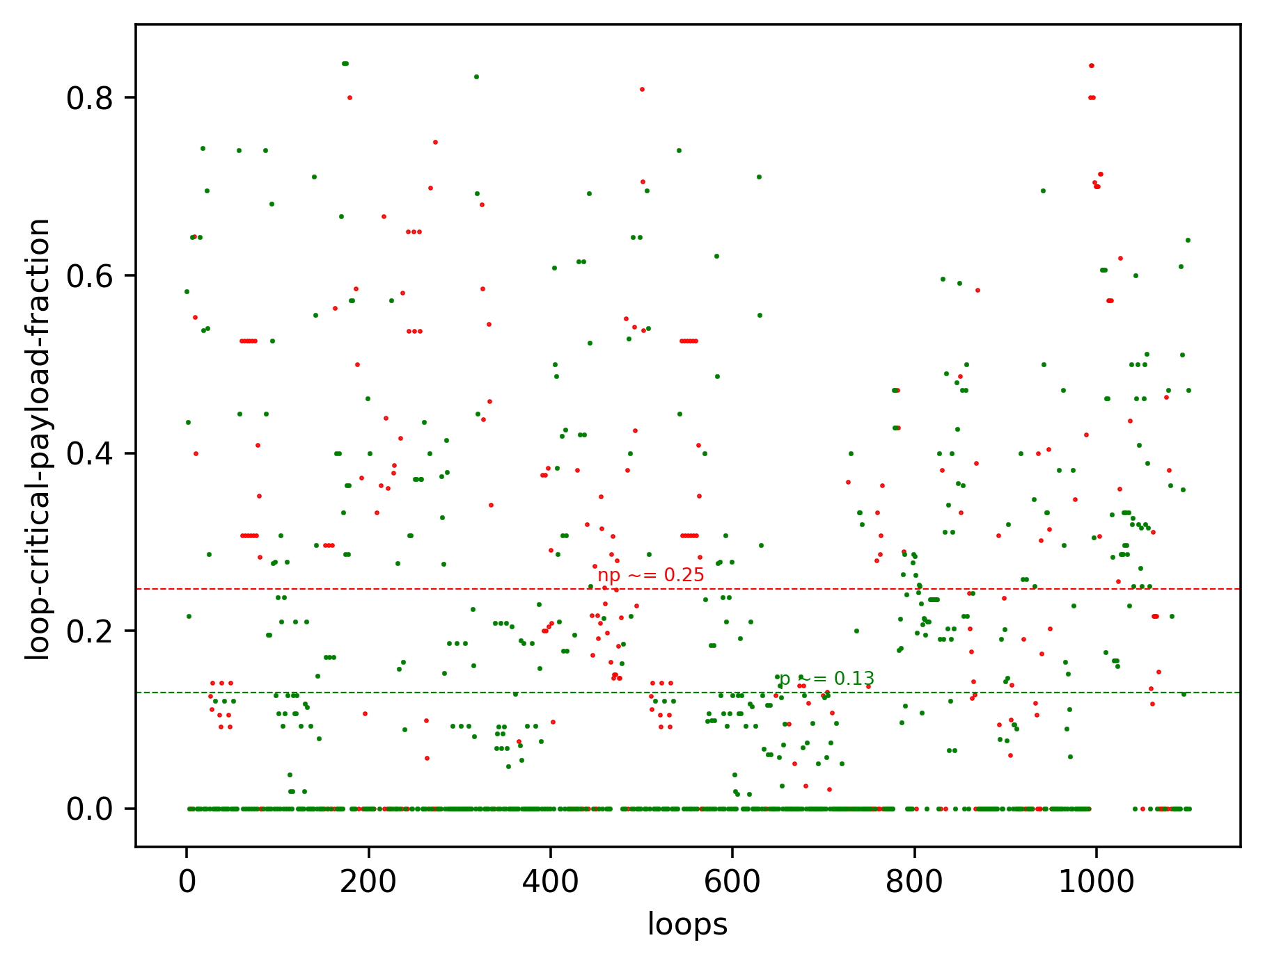
Software Metrics for Parallelism

Slide 10
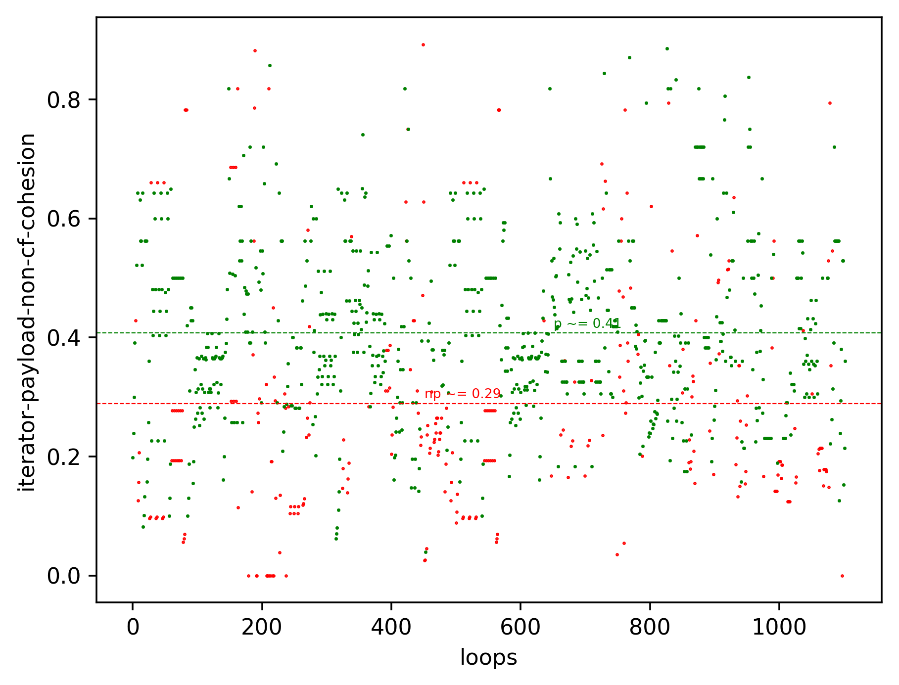
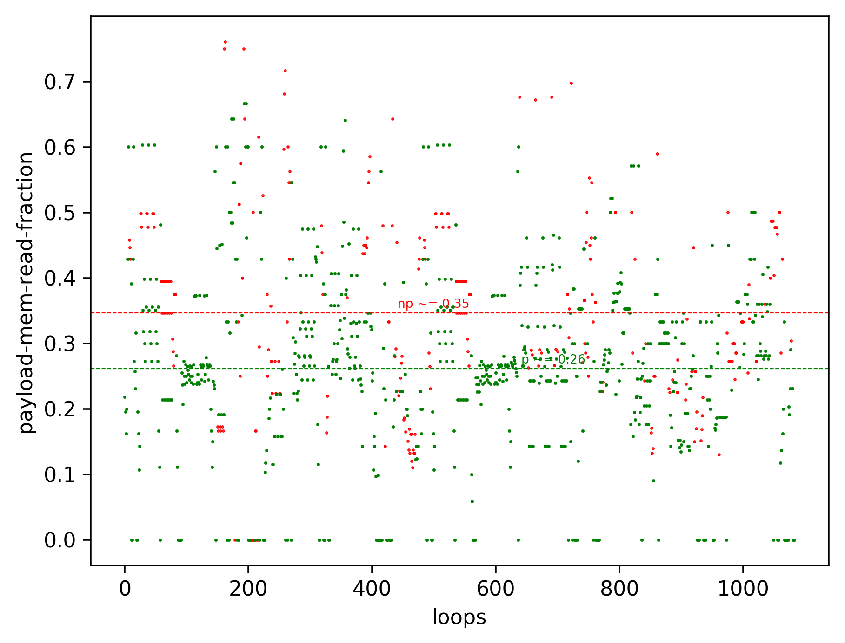
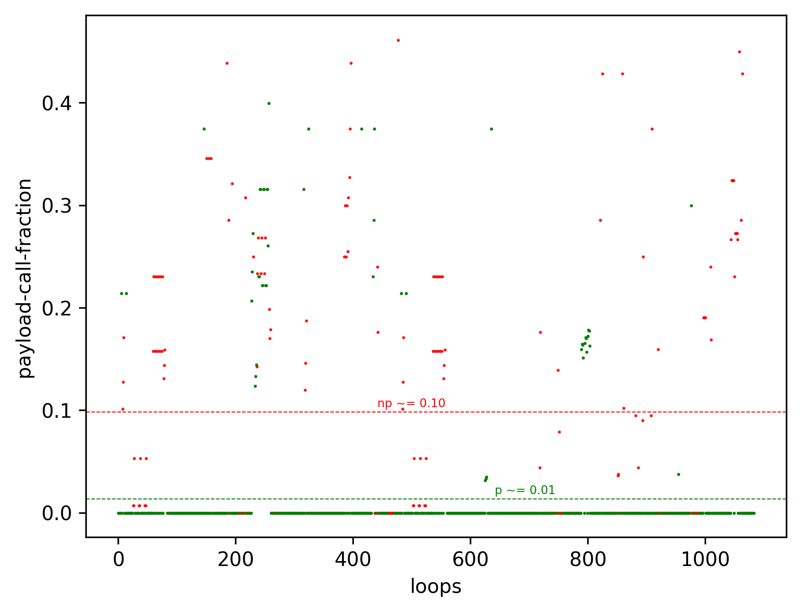
Software Metrics for Parallelism

Slide 11
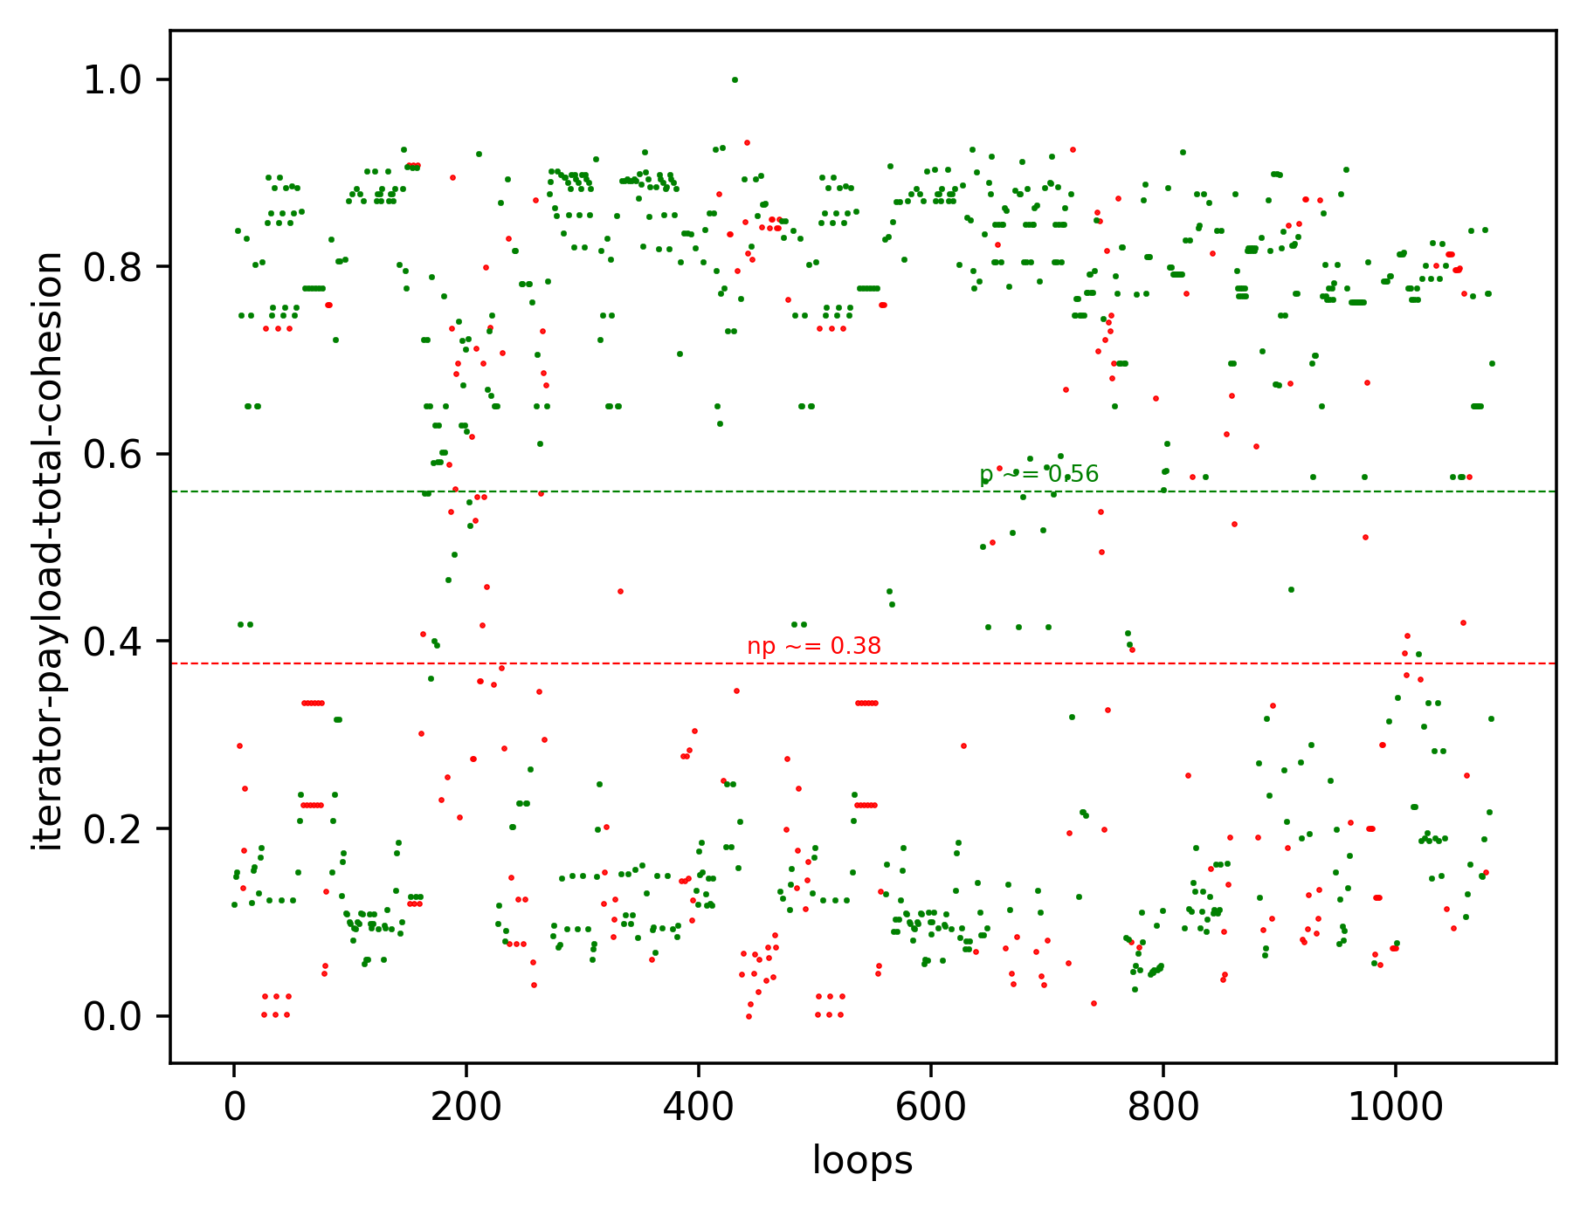
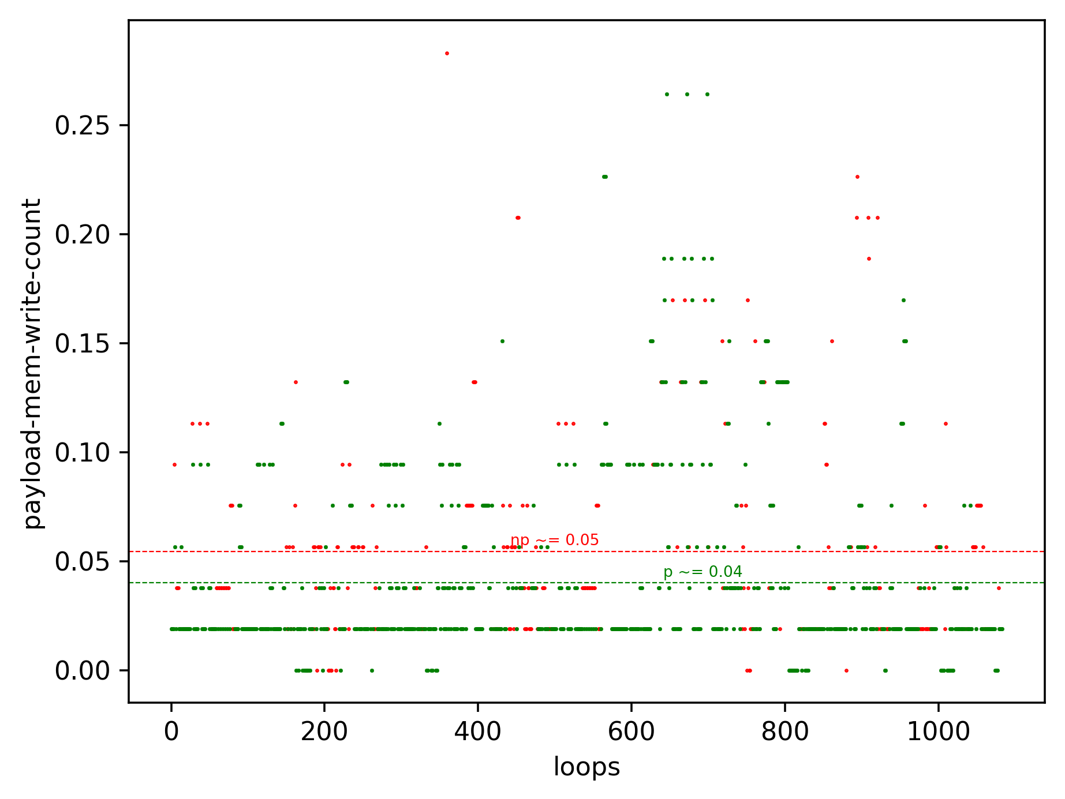
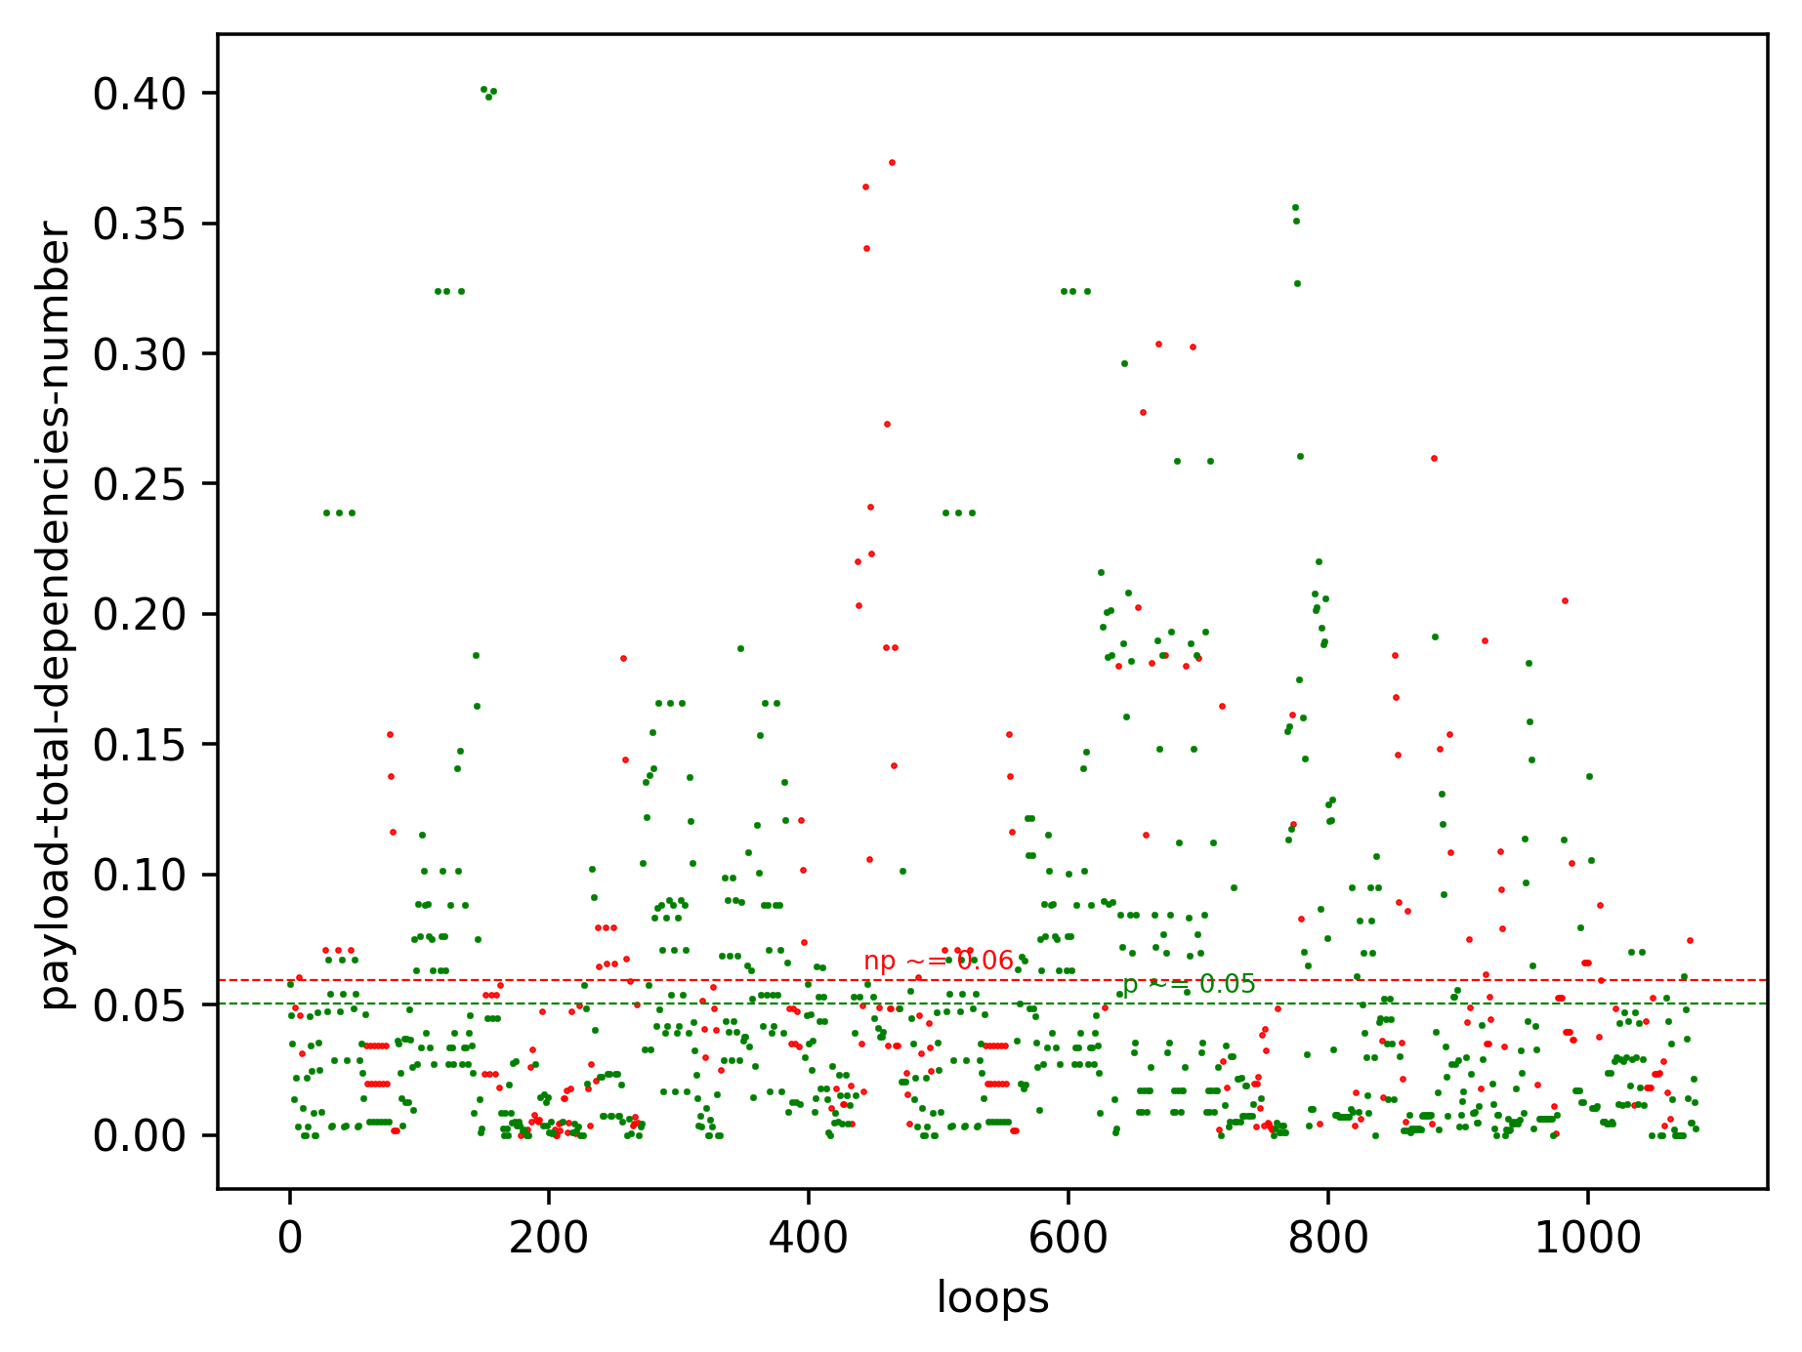
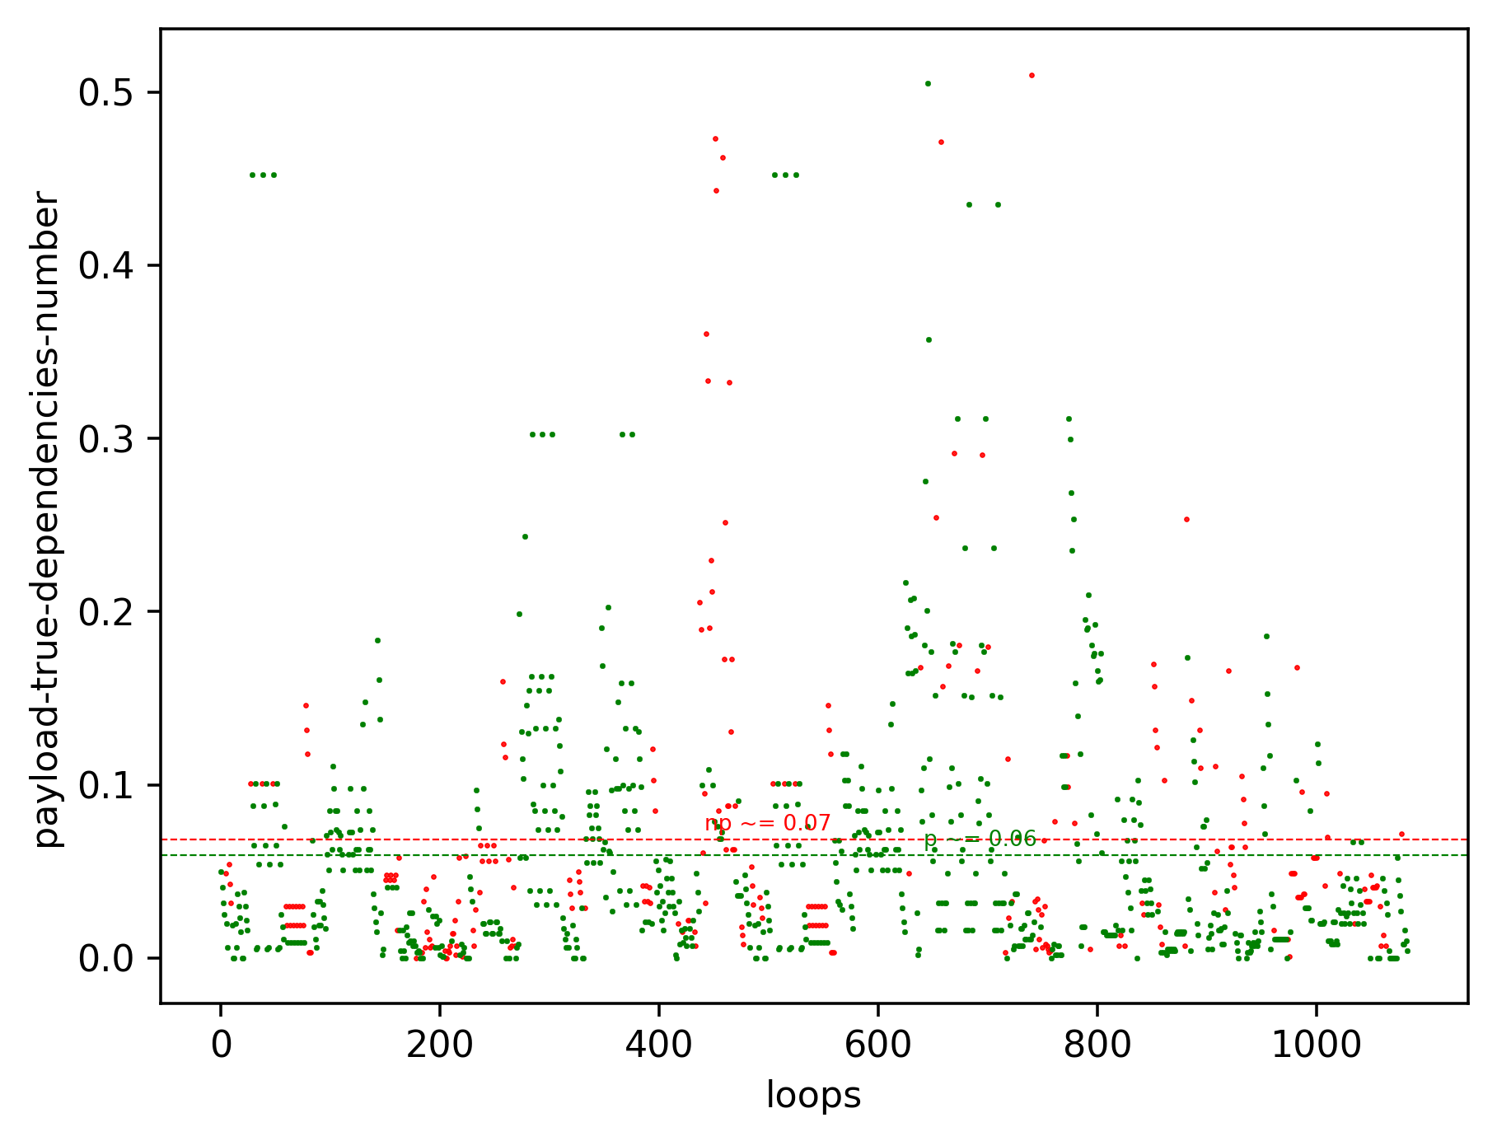
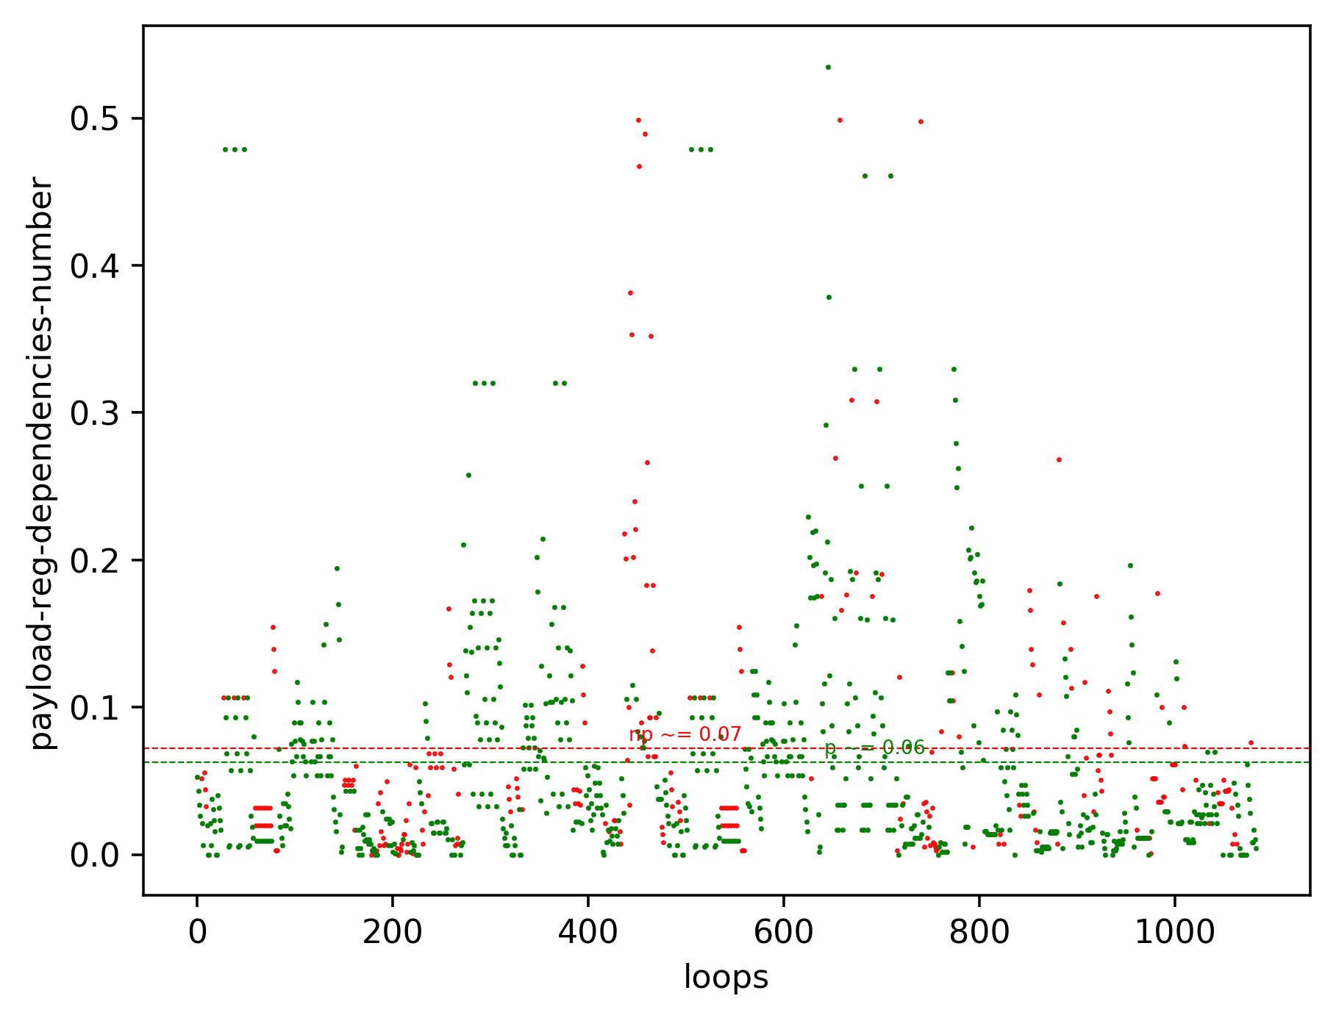
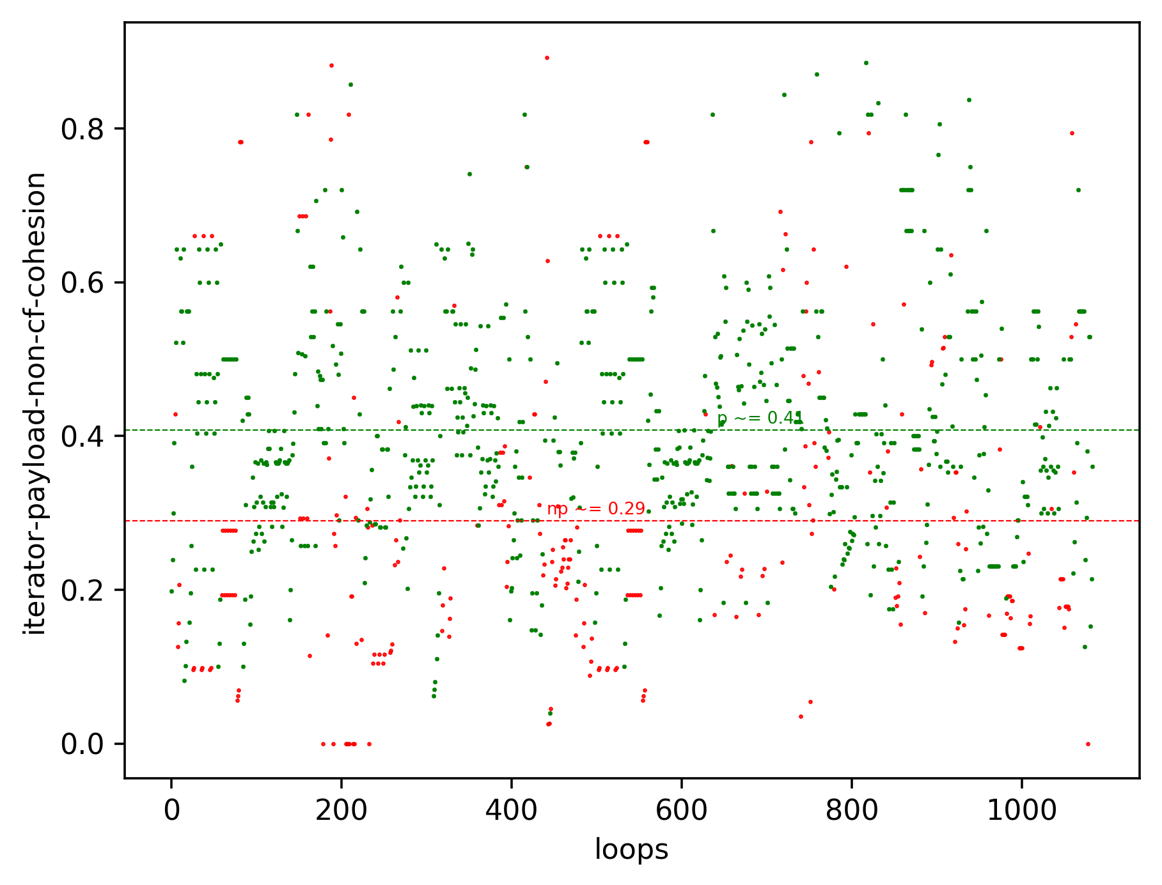
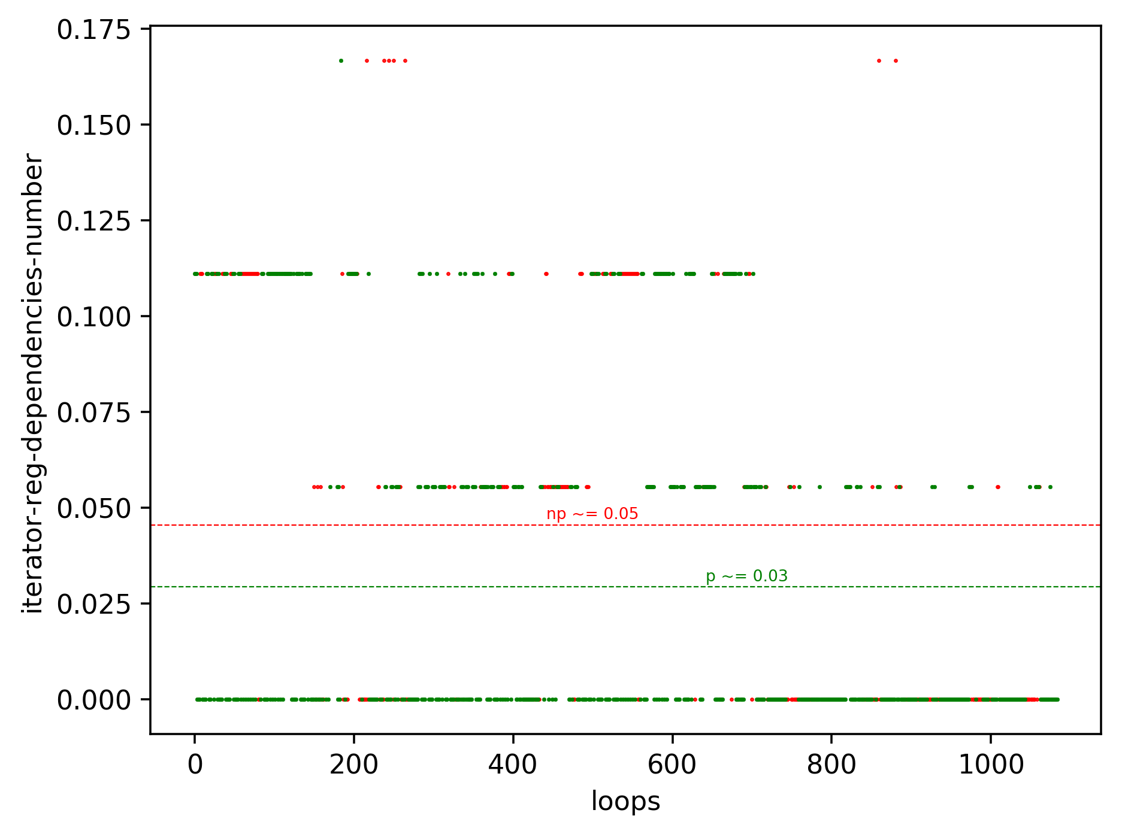
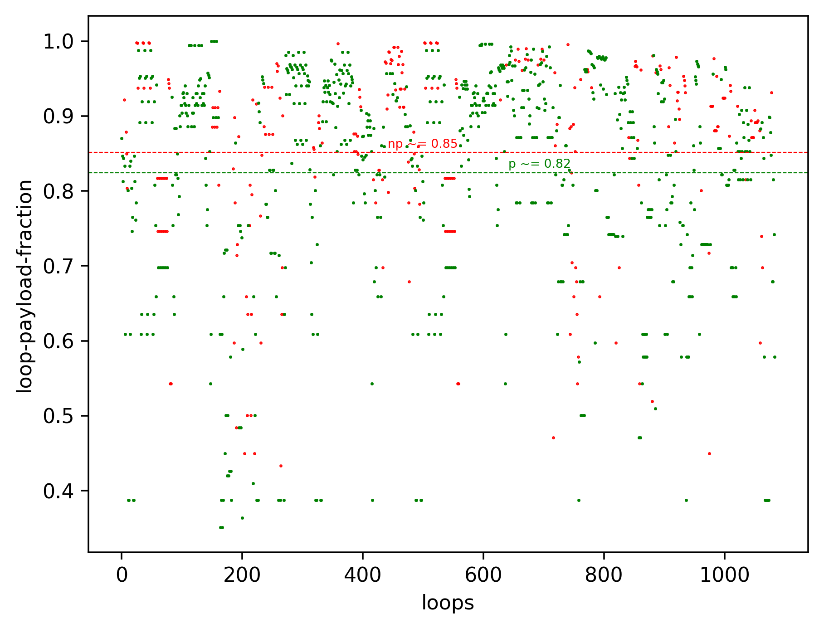
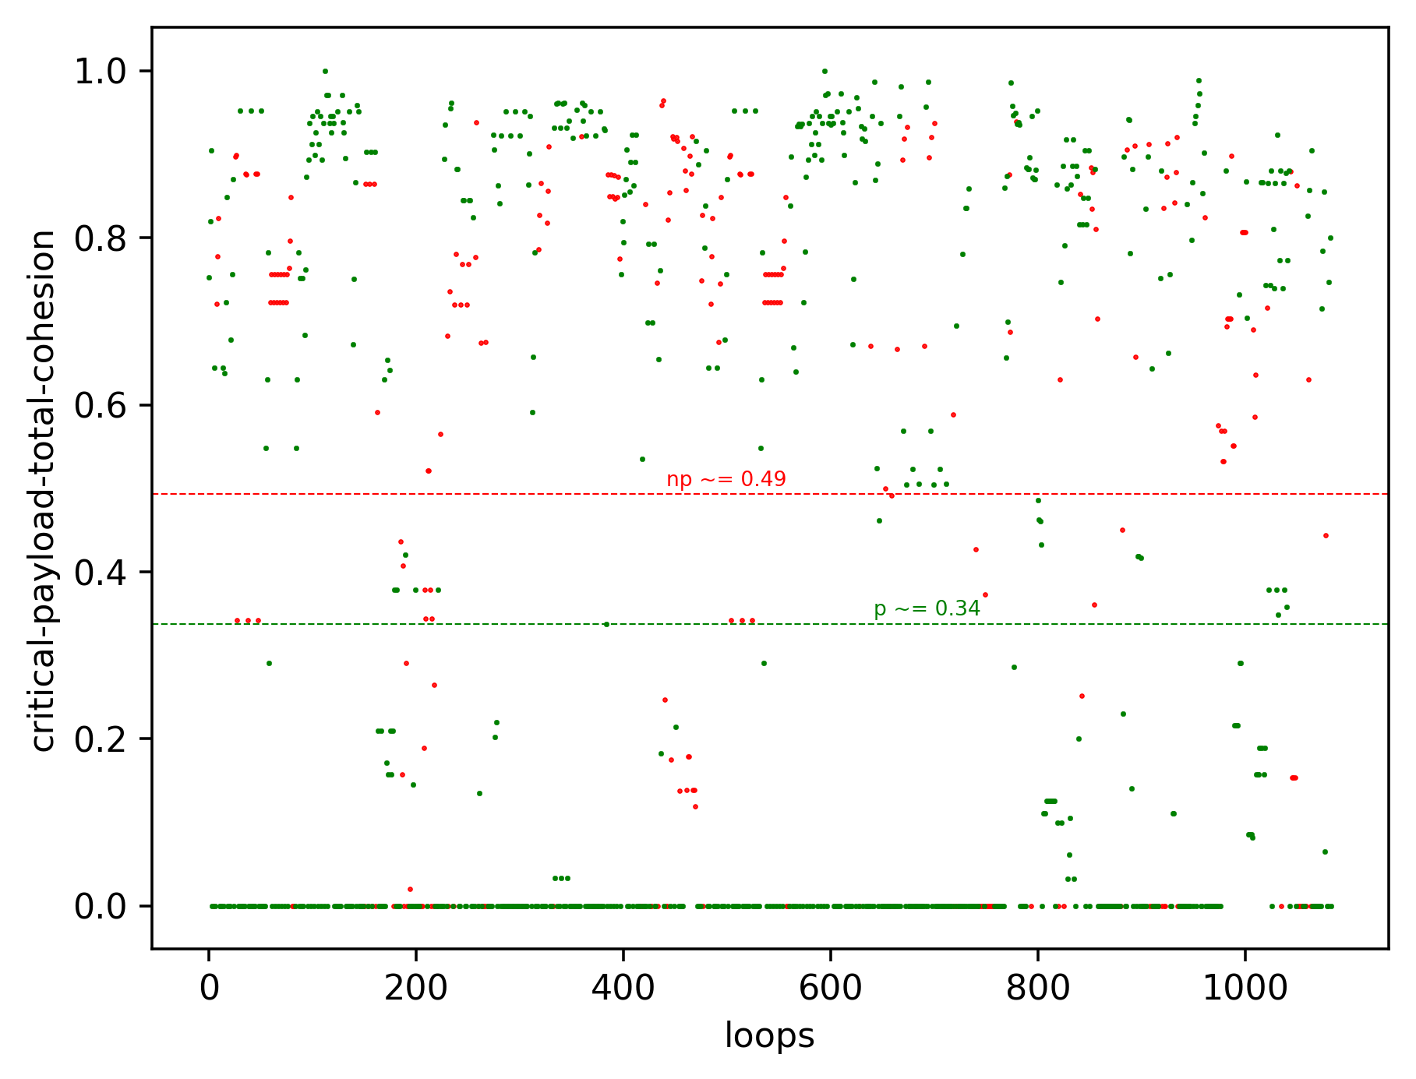
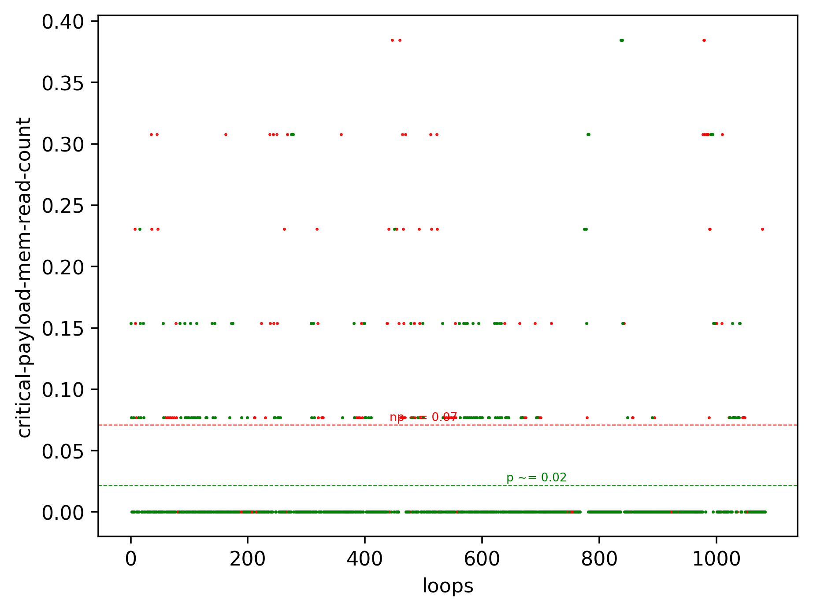
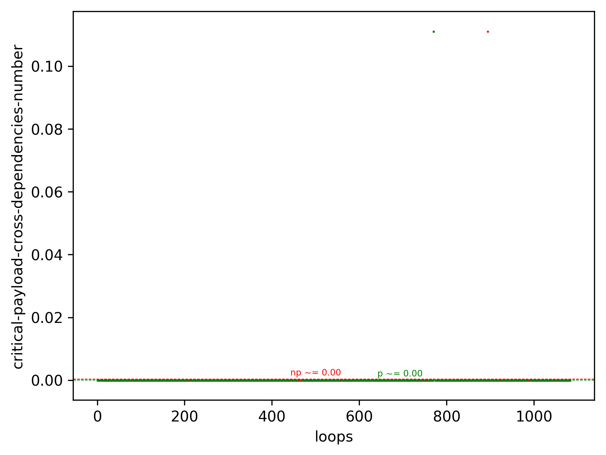
Software Metrics for Parallelism

Slide 12
Software Metrics for Parallelism
Wheras single loop parallelisability metrics show slight correlation corresponding to the basic motivation and intuition behind them
That correlation is not enough to draw a fine line between sets of parallelisible and non-parallelisible loops
Let’s try to harness all these metrics together in a machine learning model

Slide 13
Benchmarks
Brief Seoul National University (SNU) NAS Parallel Benchmarks (NPB) overview
SNU NPB Parallelisability analysis

Slide 14

Seoul National University NAS Parallel Benchmarks
Seoul National University (SNU) NASA Parallel Benchmarks (NPB)
Benchmarks Total Number | Loops Total Number | OpenMP Pragmas Number
11 | 1575 | 211
NAS Parallel Benchmarks (NPB) are a set of benchmarks targeting performance evaluation of highly parallel supercomputers
SNU NPB version of benchmarks developed at Seoul National University
SNU NPB has sequential as well as manually parallelised OpenMP version

Slide 15
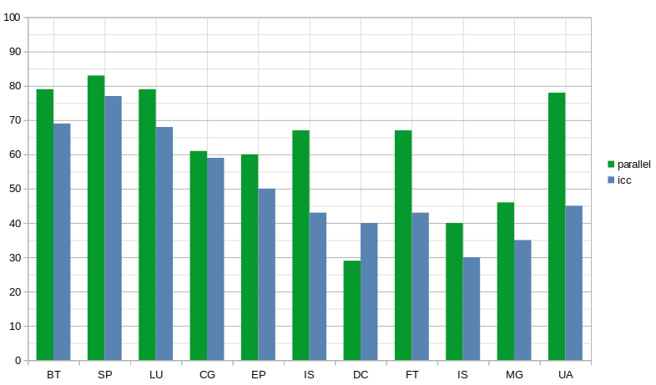
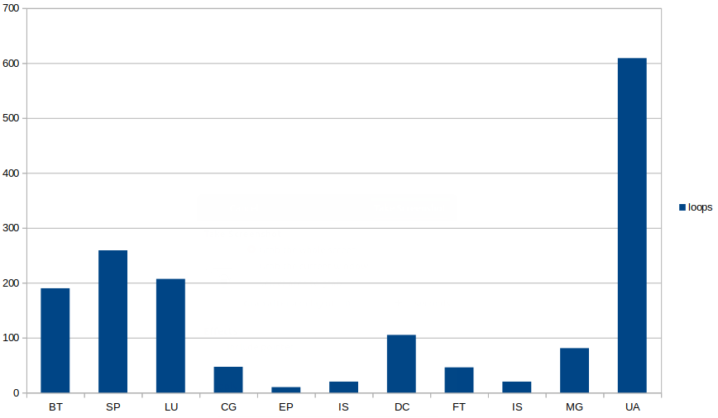
Seoul National University NAS Parallel Benchmarks
SNU NPB Parallelisability %
SNU NPB Total Loops Number

Slide 16
Intel C/C++ Compiler Parallelisation Limitations (171)
Potentially solvable limitations
SNU NASA Parallel Benchmarks Intel C/C++ Compiler Limitations (89)
Unrecognised Reduction | Array Privatization Need | Alias Analysis | Statically unknown number of iterations | Static dependencies | Other
18 | 3 | 49 | 7 | 11 | 3
Difficult to overcome: requires human source code comprehension and benchmark runtime information
SNU NASA Parallel Benchmarks Intel C/C++ Compiler Limitations (82)
Static dependencies: runtime information need | Array Privatization Need | Too complex (cross-iteration dependencies, entangled CF, indirect array referencing, etc.) | Alias analysis conservativeness | Uninlined function calls | Other
35 | 4 | 22 | 11 | 4 | 1

Slide 17
Machine Learning based Loop Parallelisability Prediction
Supervised Machine Learning Loop Classification Problem
Loop Classification Labels
Model Learning Performance
Model Use Scenarios

Slide 18

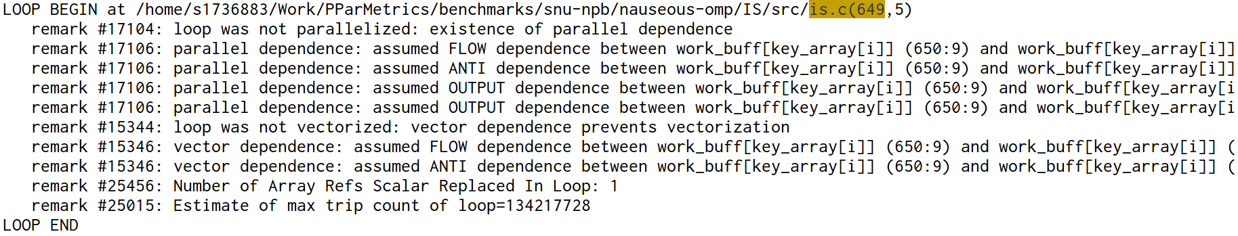



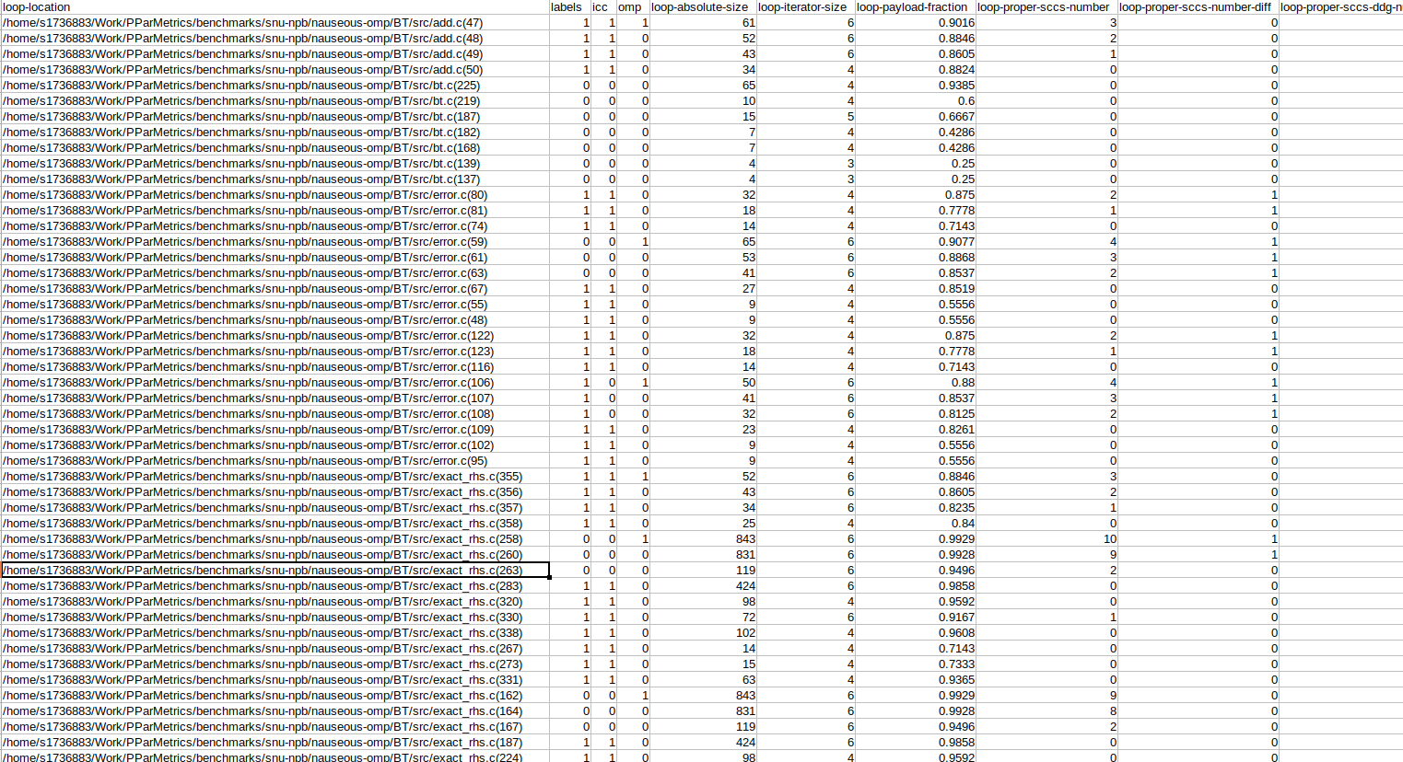

Experiment Methodology
SNU NPB
Benchmarks
ICC Compiler
ICC optimisation report
ICC Optimisation Report Parser and Analyser
-mem2reg
-O0
-disable-loop-unrolling
-disable-inlining
OpenMP pragmas
+
LLVM-based
PPar Tool
Loop metrics / features
Decision Tree Model
LLVM

Slide 19
Seoul National University (SNU) NASA Parallel Benchmarks (NPB)
Benchmarks Total Number | Loops Total Number | OpenMP Pragmas Number
11 | 1575 | 211
SNU NPB ICC optimisations
Loop Distributions | Loop Fusions | Loop Collapses | Loop Tilings
34 | 214 | 58 | 27
Parallelised | Memset Generated | Vectorised | Parallelisation Dependencies | Not a Parallelisation candidate | Vectorisation Dependencies
653 | 35 | 737 | 535 | 103 | 266
Machine Learning Parallelisability Labels (Parallelisible/Non-Parallellelisible)
SNU NPB DEVELOPER KNOWLEDGE | ICC MISSED OPPORTUNITIES | ICC
1145 / 430 | 1051 / 524 | 962 / 613

Slide 20
Decision Tree Model Learning Performance
Machine Learning Accuracy (outliers beyond 3 standard deviations have been filtered out)
Loop Classification Labels | SNU NPB developer knowledge | ICC missed opportunities | ICC
Loops | 1420 loops 995 / 425 | 1420 loops 901 / 519 | 1420 loops 812 / 608
Baseline (random) predictor accuracy | 70% | 63.5% | 57%
DT accuracy | 89-91.6% | 90-93% | 89-92.5%
Error types (safe/false negatives) (unsafe/false positives) | 43-52% 48-57% | 42-50% 50-58% | 42-49% 51-58%

Slide 21
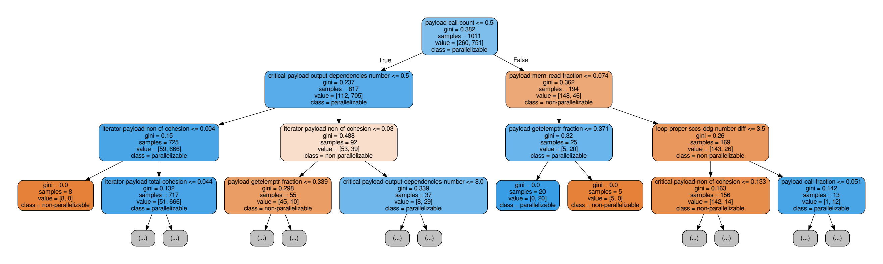
Decision Tree Model Learning Performance

Slide 22
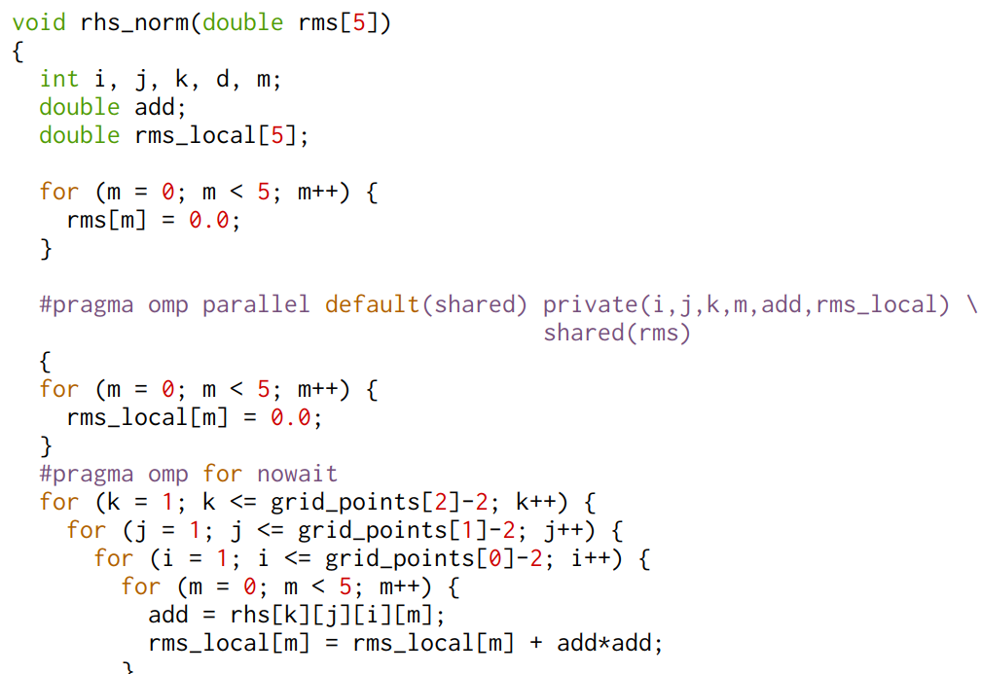
C/C++ loop
ML based Parallelisation Assistance Tool
Tool performance with ICC missed opportunities loop classification labels
ICC Compiler
Decision Tree Model
Training / Testing Set Sizes | ICC / ML | Cases Number | Real Parallel | Non-Parallel
880 / 220 161.6 / 59 | 0 / 0 | 49.9 | 1.8 | 48.1
 | 0 / 1 | 22.3 | 11.4 | 10.9
 | 1 / 0 | 6 | 6.28 | 0
 | 1 / 1 | 142.1 | 142.1 | 0
Performance
ICC | 148.1
ICC+ML | 159.8
Real | 161.6
91.6% → 98.9%
[YES] 100% / 0%
[NO] 18% / 82%
[YES] 93.4% / 6.6%
[NO] 14.5% / 85.5%
Parallelisation
Advice
* Results are relatively stable across training/testing sets size variation
Combined output utilises almost all SNU NPB available parallelism, but introduces unsafe false positives
[YES] 93.8% / 6.2%
[NO] 3.6% / 96.4%
Programmer eliminates unsafe false positives
In a perfect use scenario SNU NPB available parallelism utilisation increases on average from 91.5% to 99%
[YES] 100% / 0%
[NO] 3.6% / 96.4%

Slide 23
ML based Parallelisation Assistance Tool
C/C++ loop
Tool performance with SNU NPB developer loop classification labels
ICC Compiler
Decision Tree Model
Training / Testing Set Sizes | ICC / ML | Cases Number | Real Parallel | Non-Parallel
867 / 217 173.3 / 43.6 | 0 / 0 | 36 | 3.4 | 32.6
 | 0 / 1 | 32.4 | 21.4 | 11
 | 1 / 0 | 5.5 | 5.5 | 0
 | 1 / 1 | 143 | 143 | 0
Performance
ICC | 148.5
ICC+ML | 169.9
Real | 173.3
85.7% → 98%
[YES] 100% / 0%
[NO] 36% / 64%
[YES] 93.7% / 6.3%
[NO] 21.4% / 79.6%
Parallelisation
Advice
Combined output utilises almost all SNU NPB available parallelism, but introduces unsafe false positives
[YES] 94% / 6%
[NO] 9.5% / 91.5%
Programmer eliminates unsafe false positives
In a perfect use scenario SNU NPB available parallelism utilisation increases on average from 86% to 98%
[YES] 100% / 0%
[NO] 9.5% / 91.5%

Slide 24
ML based Parallelisation Assistance Tool
C/C++ loop
Answer | ICC | ML | ICC + ML | ICC + ML + Human
YES | Precise | Unsafe False Positives | Unsafe False Positives | Precise
NO | Lost opportunity | Lost opportunity | Increased Parallelism Utilisation | Increased Parallelism Utilisation
ICC Compiler
Decision Tree Model
1/0 Shielding
Parallelism Utilisation Increase
False Positives Danger
Parallelisation
Advice
Safe
Parallelism Utilisation Increase

Slide 25
Thank you for your attention!

Slide 26
Backup
Source code examples
Additional Tables

Slide 27
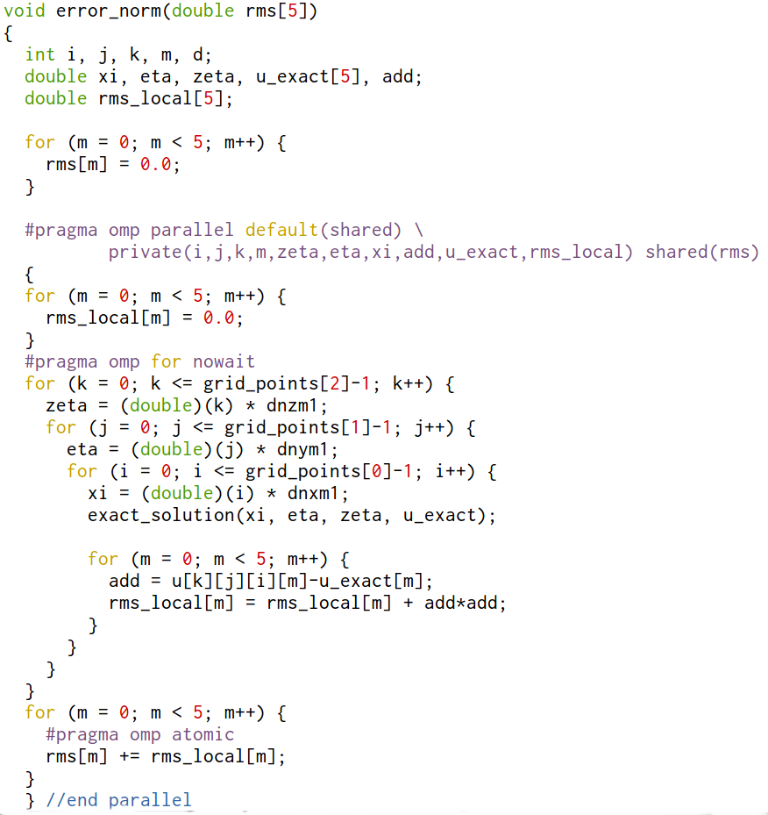
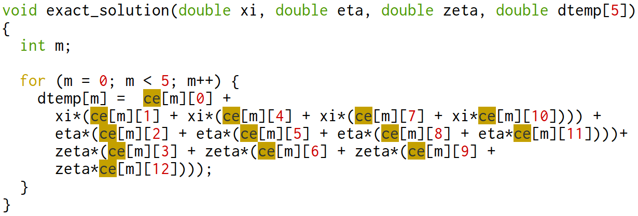
BT, SP, LU benchmarks: array privatization need
Loop nest (k,j,i) accumulates the total error (difference between solution u and the exact solution u_exact) via a reduction
Every iteration (k,j,i) uses temporary rms_local[] memory to compute and store one little portion of the reduction
This rms_local[] introduces cross-iteration dependency, since it is being reused on different loop nest iterations
Programmer replicates this temporary rms_local[] memory with OpenMP semantics and parallelises the loop nest
Intel Compiler does not automatically do such a parallelising transformation

Slide 28
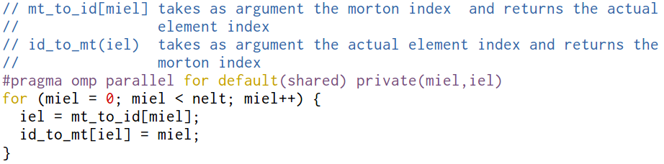
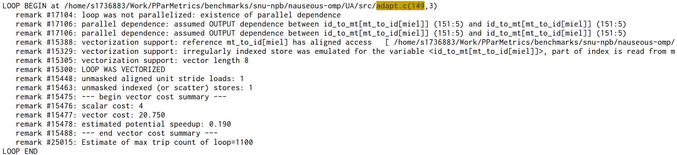
UA benchmark: static dependence (runtime information need)
Output
Loop has an output dependency and Intel compiler correctly detects it
Intel compiler does not parallelise the loop, but can vectorise it
Programmer knows, that dependence does not materialise and preceeds the loop with an OpenMP pragma

Slide 29
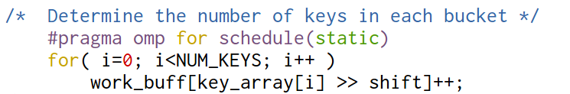
IS benchmark: static dependence (runtime information need)
True
Anti
Output
Intel Compiler assumes all static dependencies to materialise and does not proceed with the parallelisation of the loop
Programmer knows that

Slide 30
Intel C/C++ Compiler optimisation report parsing and analysis problems
Intel Compiler uses cost model to decide on how to process parallelisible loops and loop nests (parallelise, vectorise, generate memset/memcpy, leave sequential)
Has been vectorised != absence of parallelisation restricting dependencies
A set of transformations applied in order to enable loop parallelisation (loop distribution, fusion, tiling, collapsing, interchange, etc.)
Loop eliminations (unrolling, inlining,
Machine Learning Parallelisability Labels (Parallelisible/Non-Parallellelisible)
OMP+MANUAL+ICC | MANUAL+ICC | ICC
1145 / 430 | 1051 / 524 | 962 / 613

Slide 31
Seoul National University NAS Parallel Benchmarks
Benchmarks | Brief Description | Benchmark Parallelisability (ICC+OMP/ICC) | Loops Number | Loops Nature
 |  |  |  | OMP+ ICC | ICC
BT | Mostly all loops are parallelisible by Intel Compiler. Multidimensional arrays with parallel access patterns. | 79% / 69% | 190 | 150 / 30 | 131 / 59
SP |  | 83% / 77% | 259 | 217 / 42 | 200 / 59
LU |  | 79% / 68% | 207 | 164 / 43 | 141 / 64
CG | Half of the benchmark are parallelisible reductions (even without OpenMP compiler hints), the other half are | 61% / 59% | 47 | 29 / 18 | 28 / 19
EP | Small, nothing interesting | 60% / 50% | 10 | 6 / 4 | 5 / 5
IS | Materialisation of loop cross-iteration dependencies depends on a dynamic program properties. Programmer knows application’s runtime behavior and inserts OpenMP pragmas, but compiler has to be conservative. | 67% / 43% | 20 | 8 / 12 | 6 / 14
DC |  | 29% / 40% | 105 | 30 / 75 | 21 / 84
FT |  | 67% / 43% | 46 | 29 / 17 | 29 / 17
IS |  | 40% / 30% | 20 | 8 / 12 | 6 / 14
MG |  | 46% / 35% | 81 | 37 / 44 | 28 / 53
UA | Big complex loops with several levels of inlining required, indirect array referencing, entangled CF, cross-iteration dependencies. At least dynamic analysis is needed. Human program comprehension preferably. | 78% / 45% | 609 | 475 / 134 | 276 / 333

Slide 32
Loops challenging ICC
Loops with cross-iteration dependencies
Loops with a statically unknown number of iterations
Loops with unidentified control variable
Loops with function calls inside the body
Loops with multiple exits (break, return statements, etc.)

Slide 33
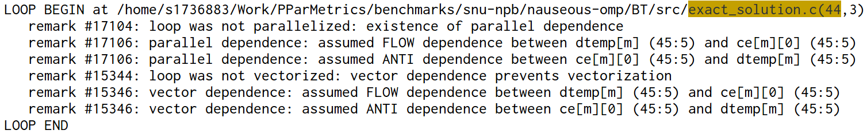

Slide 34
Loop classification problem [1]: what is parallel and what is not?
How to label these loops for a ML-based tool?
OpenMP semantics is supposed to replicate rmh_local[] and ensure atomic mutually exclusive access to a shared rhs[]
OpenMP puts in an additional semantics, without which there is a memory dependence
No dependence in OpenMP version, but memory cross-iteration dependence in the sequential version
Need to provide memory in rhs_local[] for every parallel thread, before we parallelise it. Compiler does not do it automatically, without programmer’s instruction
Function calls scare conservative compiler. Should we classify the code as it is or only after assumed inlining is done?

Slide 35
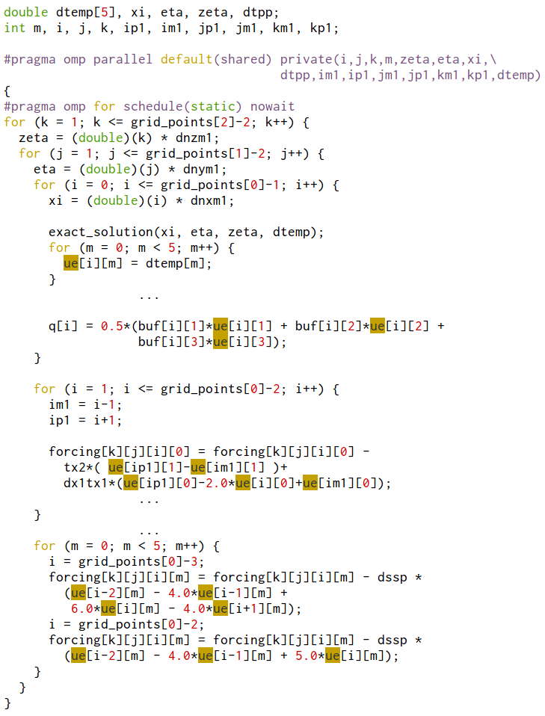
BT, SP, LU benchmarks:
ue[PROBLEM_SIZE+1][5] is a global 2D array, which contains different values as a function of 2 loop nest iteration (k,j)
Programmer does not replicate ue’s memory per every thread, but seemingly relies on the non-overlapping timing of loop iterations
Intel Compiler correctly detects all dependencies and refuses to parallelise this code
True
Anti

Slide 36
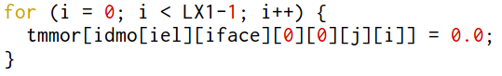
OpenMP pragma [3]: UA
Output
Loop has an output dependency and Intel compiler correctly detects it
Intel compiler does not parallelise the loop, due to an output dependency
Same-value output dependency

Slide 37
Getting ML classification labels for loops: methods and challenges
Methods and sources of loop classification labels extraction:
Seoul National University (SNU) NAS Parallel Benchmarks (NPB) with added OpenMP pragmas
Intel C/C++ Compiler (ICC) optimisation reports
Manual SNU NPB source code study to check and verify parallelisation labels
Task challenges and complications:
Seoul National University (SNU) NAS Parallel Benchmarks (NPB) with added OpenMP pragmas
Intel C/C++ Compiler (ICC) optimisation reports
Manual SNU NPB source code study to check and verify parallelisation labels

